Slide 1





Product Studio
Sprint 1
Team 68 – sEnergy September 27, 2019
Jay Lee, MBA
Nilay Altun, CS
Adam Levin, CS
Harry Li, ORIE
Ami Mehta, AAP

Slide 2

How Might We?
Leverage federal and state offered energy credits
to incent consumers to better conserve energy?

Slide 3
How Might We?
Leverage federal and state offered energy credits
to Incent consumers to better conserve energy?

Slide 4
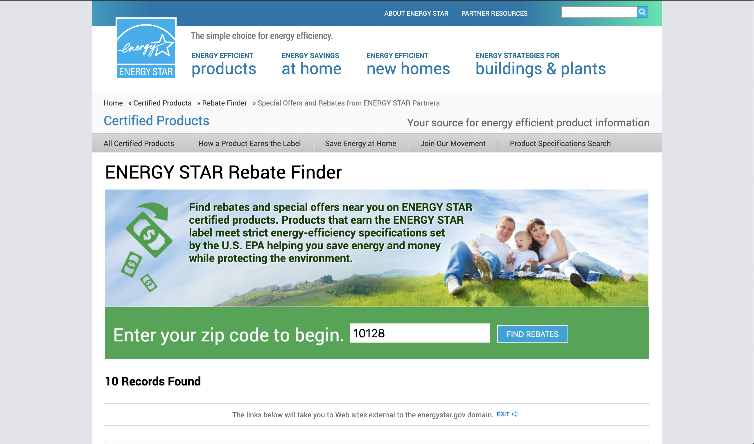
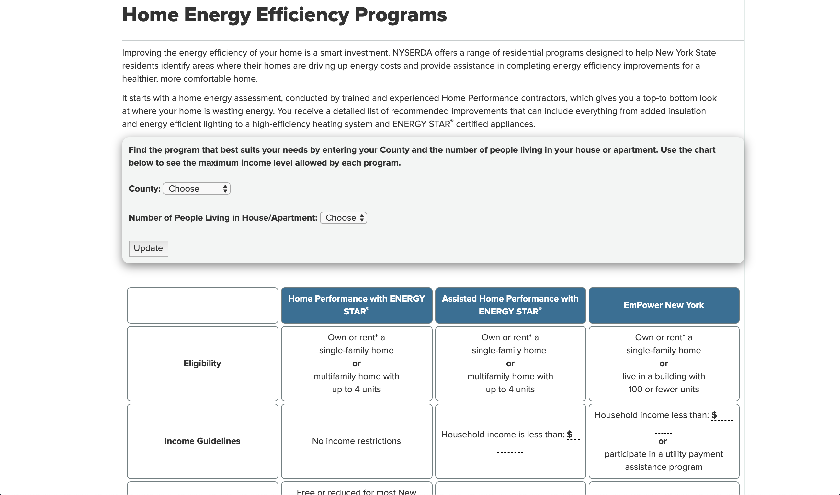
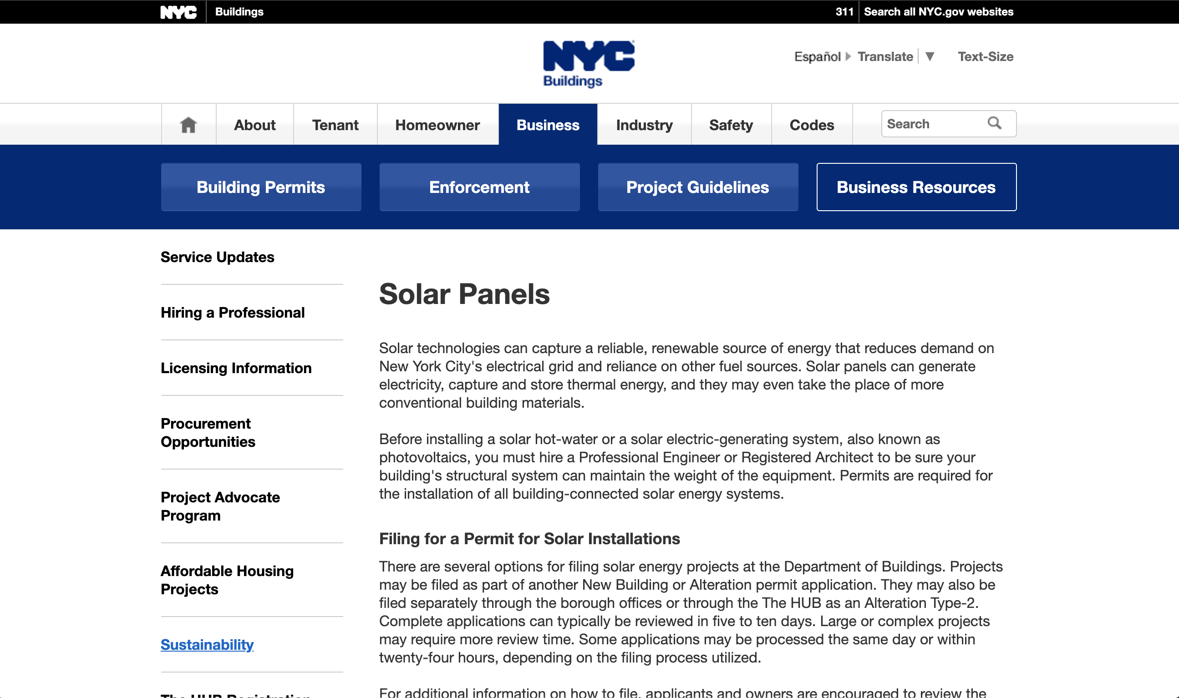
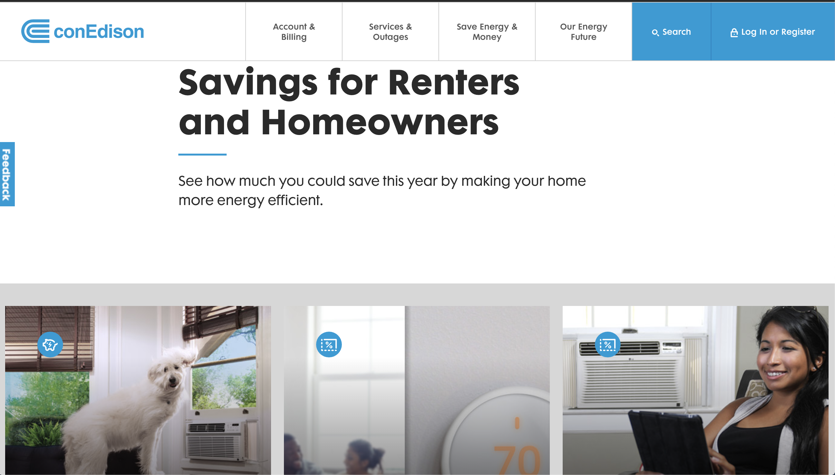


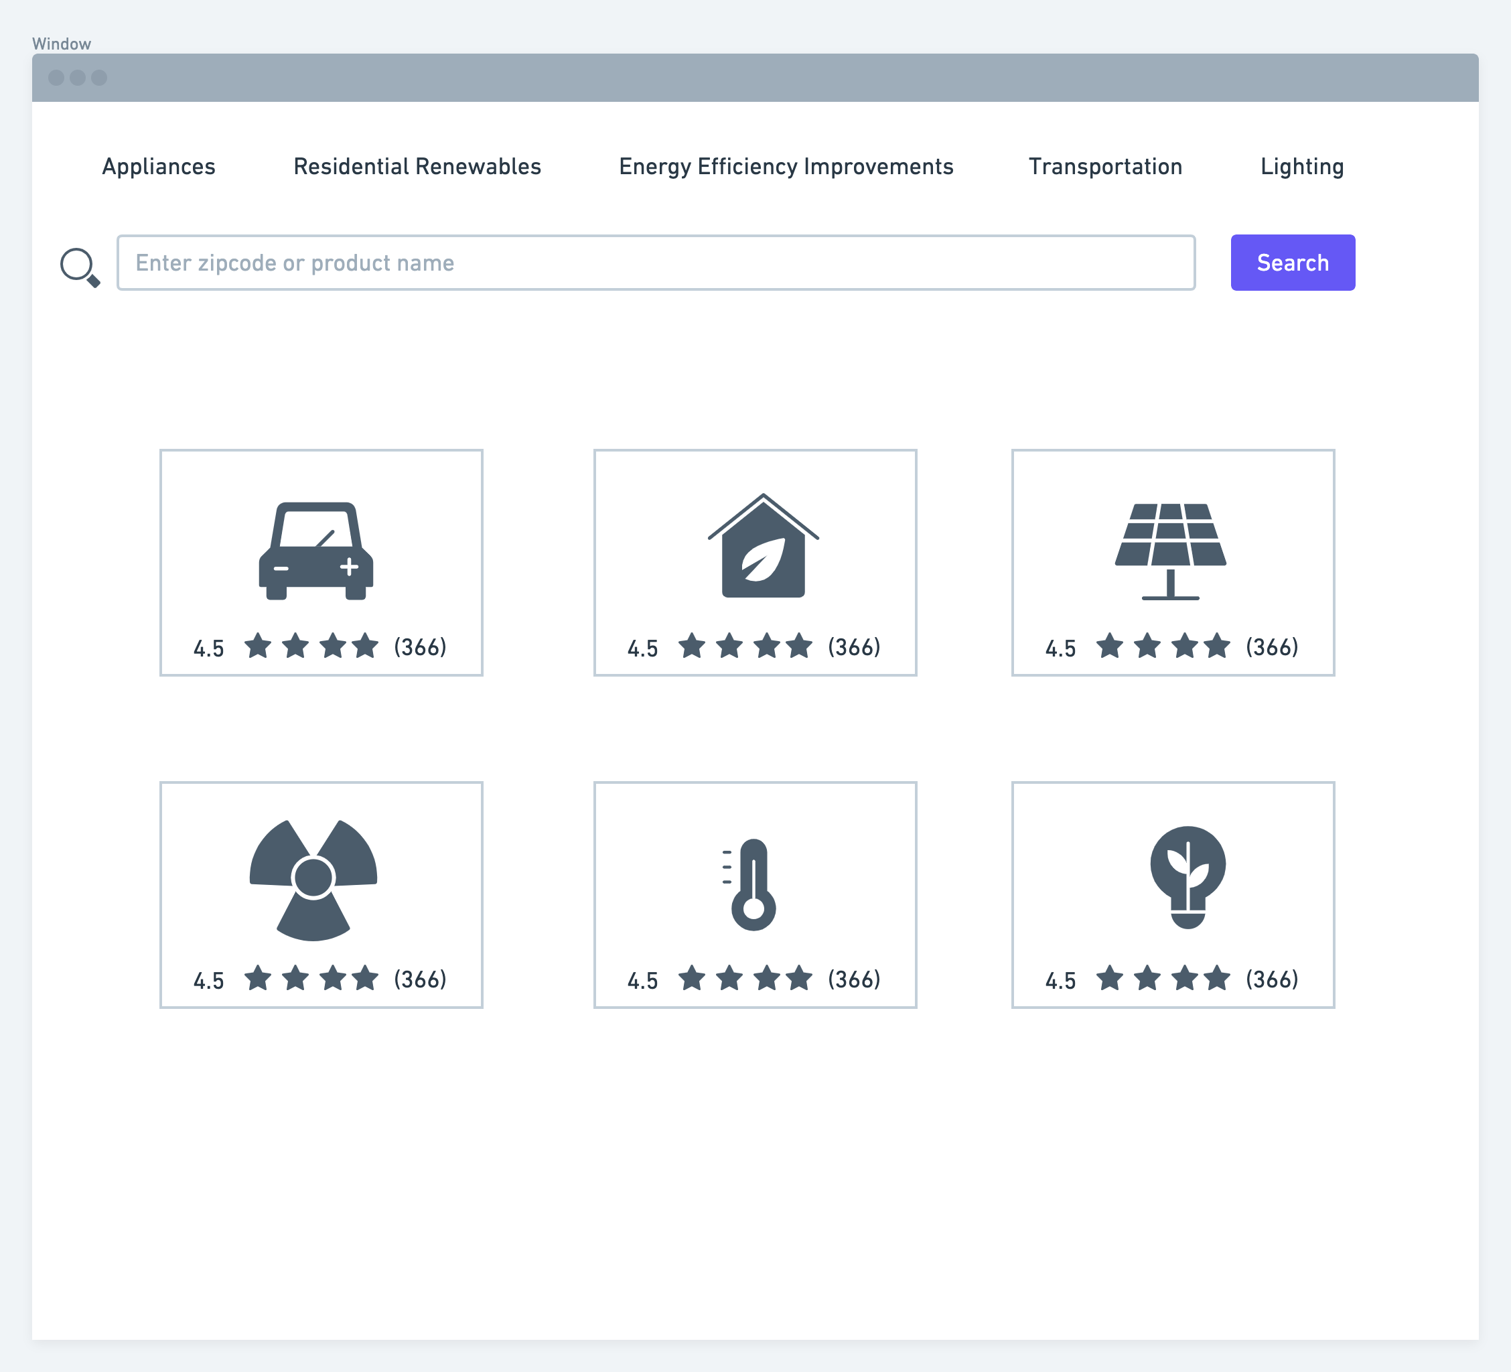
One Stop Shop for Energy Incentives
Federal Incentives
State Incentives
Local Incentives
Utility Companies Incentives
Notes:
-As a consumer today how can I figure out what energy incentives are available?
-I currently have to go to many different websites
-And how do I know which are worth my while?
-This information is difficult to find – I might hear anecdotes from friends or family, and if I try hard enough some tidbits in online forums
-The One-Stop Shop for Energy Incentives will make my shopping much easier
-I can search by zip code or product to find exactly what I am looking for
-I can filter by category or by eligibility
-I can see reviews of each incentive from consumers like me
-I can get tips from people who’ve successfully navigated each process
-When I go shopping I can be fully informed of net prices
-The One-Stop Shop will increase adoption of green products and services by making it easier for consumers like me to find out about them

Slide 5
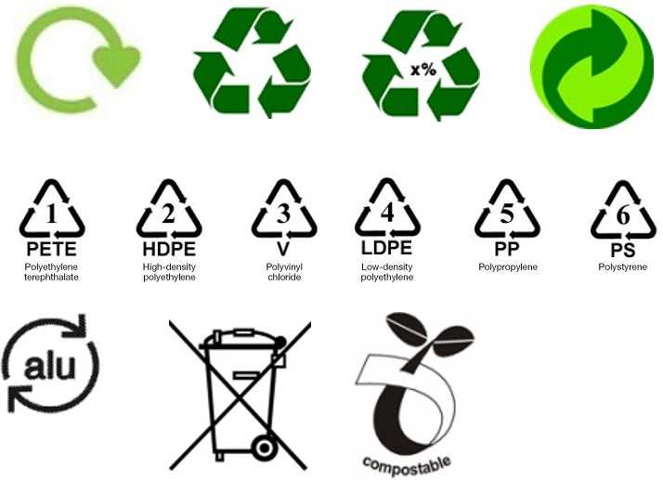
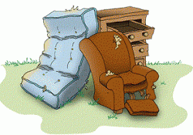
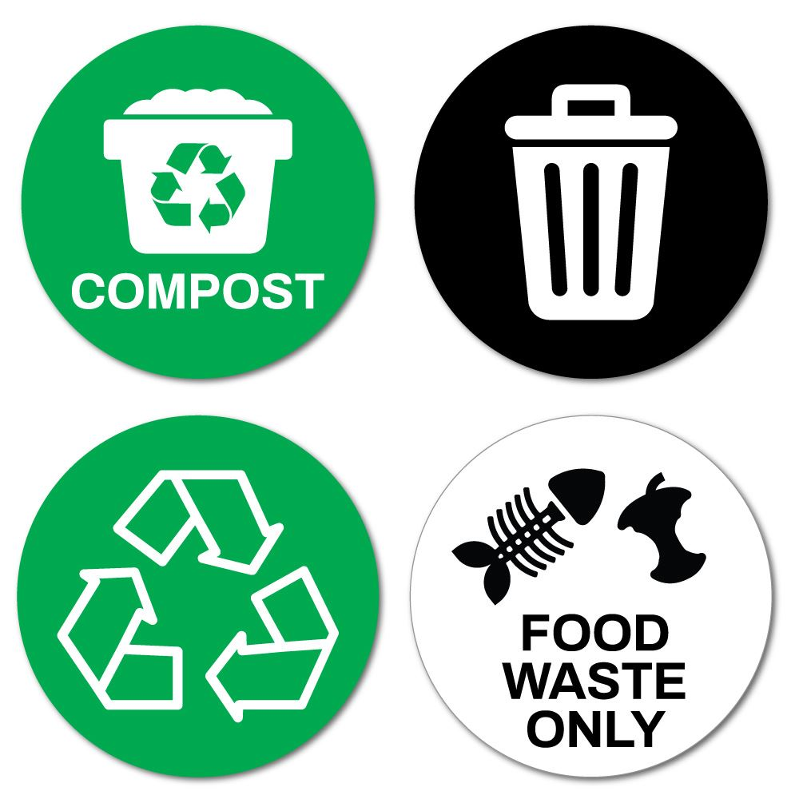



Recycle Expert
Recycling made so easy

Slide 6
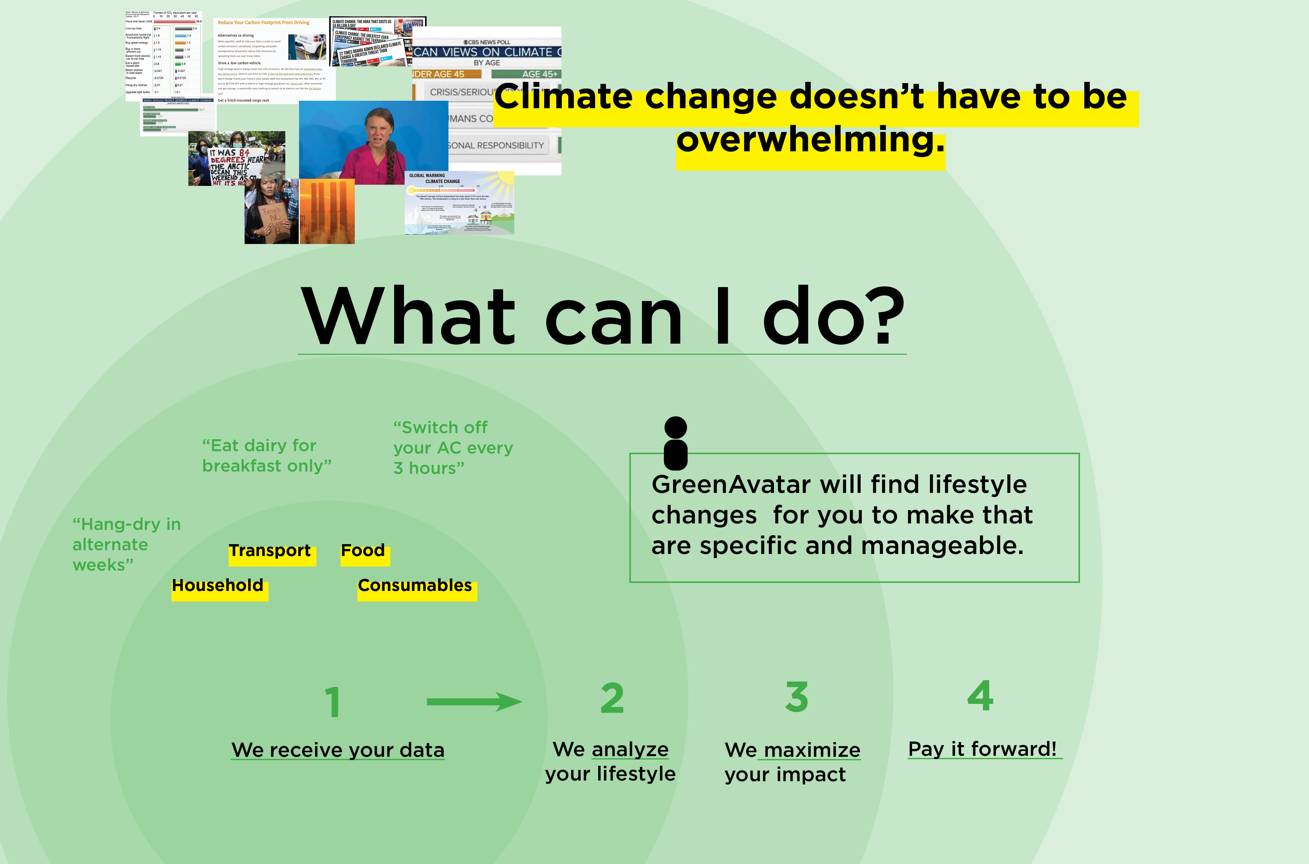

Slide 7
How Might We?
Incent consumers to better conserve energy?
One Stop Shop for
Energy Incentives
Recycle Expert
GreenAvatar
Notes:
Number of Audience Votes: GreenAvatar > Recycle Expert > One Stop Shop for Energy Incentives
Potential Improvement: “combine (?)” recycle expert with GreenAvatar

Slide 8
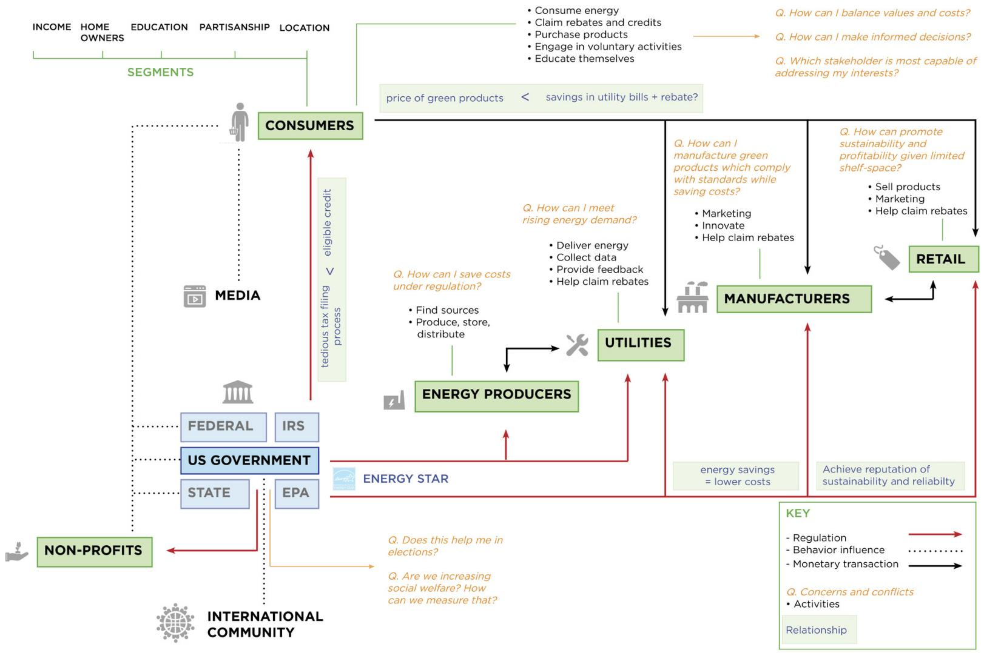

Slide 9
How do tax credits/rebates work?
What are the use cases and variations?

Slide 10
How do they perceive energy incentives?
What factors drive changes in behavior?
How do tax credits/rebates work?
What are the use cases and variations?

Slide 11
How do they perceive energy incentives?
What factors drive changes in behavior?
What emerging technologies address energy conservation?
How do tax credits/rebates work?
What are the use cases and variations?

